Slide 1

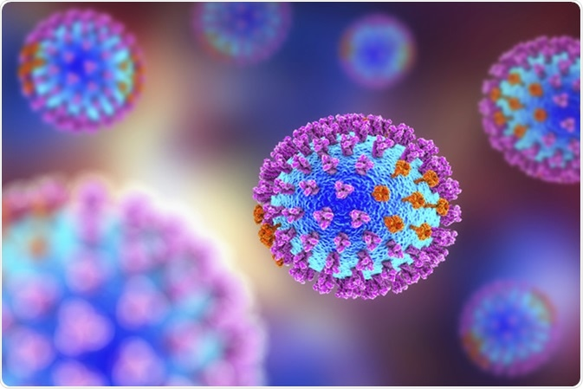
National Influenza Centre – South Africa
Respiratory Virus Genomics Workshop
8 September 2025
Centre for Respiratory Diseases and Meningitis
National Institute for Communicable Diseases
of the National Health Laboratory Service
Nicole Wolter

Slide 2

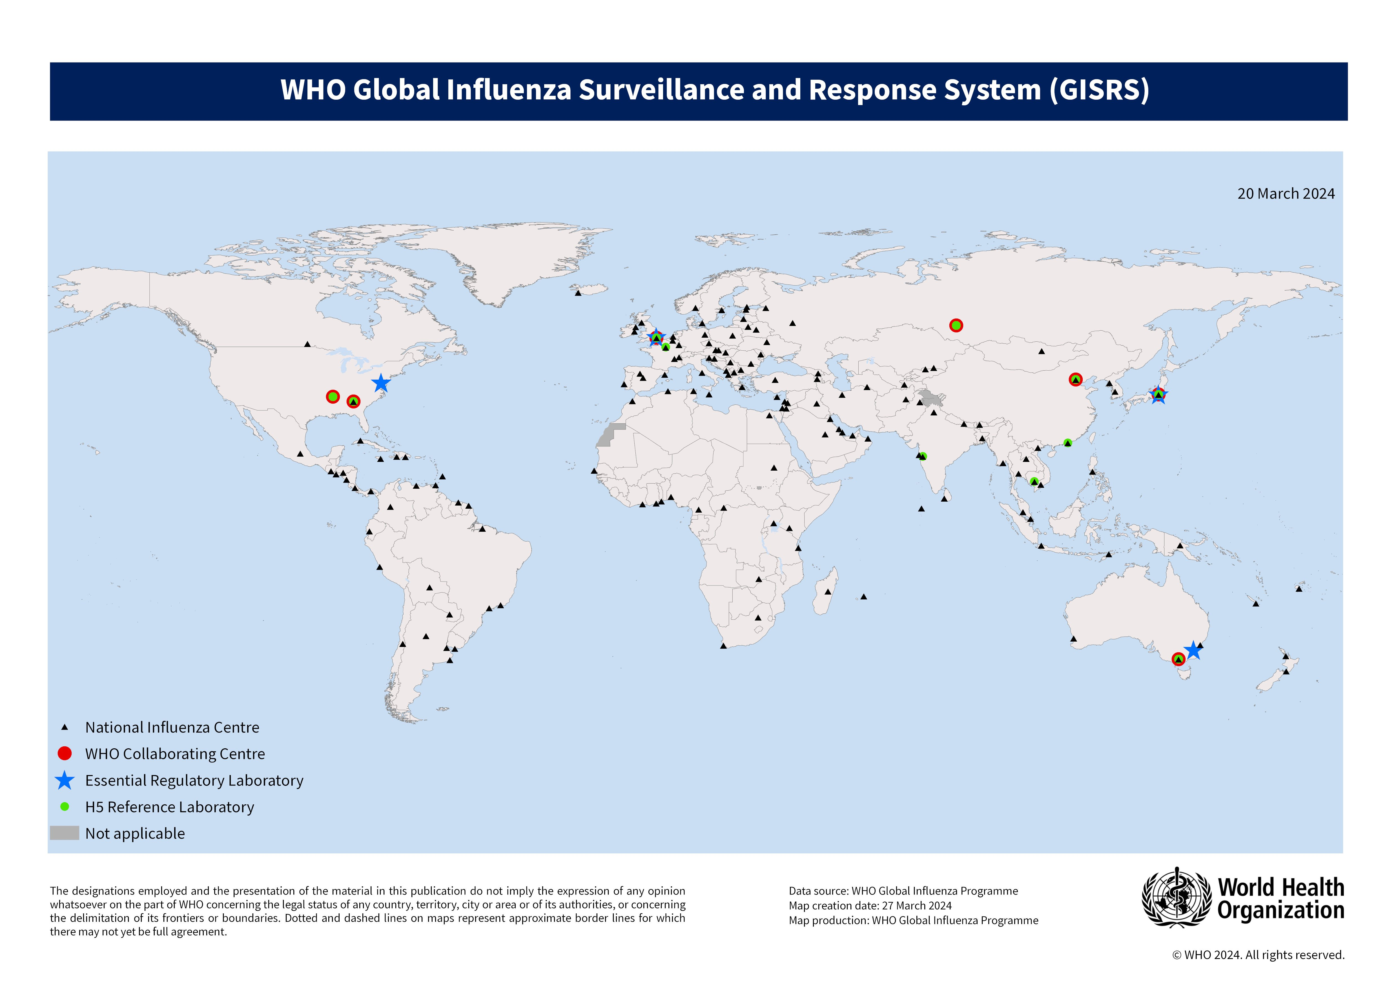
WHO's Global Influenza Surveillance and Response System (GISRS)
Primary global mechanism and resource for surveillance and control of influenza
NIC
WHO CCs
WHO recommendation for composition of annual influenza vaccine
Collect influenza specimens
Preliminary analysis
Advanced antigenic and genetic analysis
National influenza reference lab
Influenza surveillance in humans
Monitor evolution of circulating influenza viruses and detect emergence of novel influenza viruses with pandemic potential
WHO GISRS established in 1952
Global Influenza Surveillance and Response System (GISRS)

Slide 3

Respiratory Virus Genomic Collaboration
Partners:
National Institute for Communicable Diseases, Johannesburg, South Africa (CRDM = NIC)
Noguchi Memorial Institute for Medical Research (NMIMR), Accra, Ghana (National Influenza Laboratory = NIC)
Institut Pasteur de Madagascar (IPM), Antananarivo, Madagascar (National Influenza Laboratory = NIC)
National Public Health Laboratory (NPHL), Nairobi, Kenya (Influenza Laboratory = NIC)
University Teaching Hospital (UTH) (Virology Laboratory = NIC) and Zambia National Public Health Reference Laboratory, Lusaka, Zambia
National Institute of Health (INS), Marracuene, Mozambique (Virology Laboratory=NIC)
US Centers for Disease Control and Prevention (CDC) , Atlanta, USA
Countries targeted for reporting in 2023
Countries newly reporting in 2022
Countries with sentinel surveillance
AFRO Member States
EMRO Member States
Not applicable

Slide 4
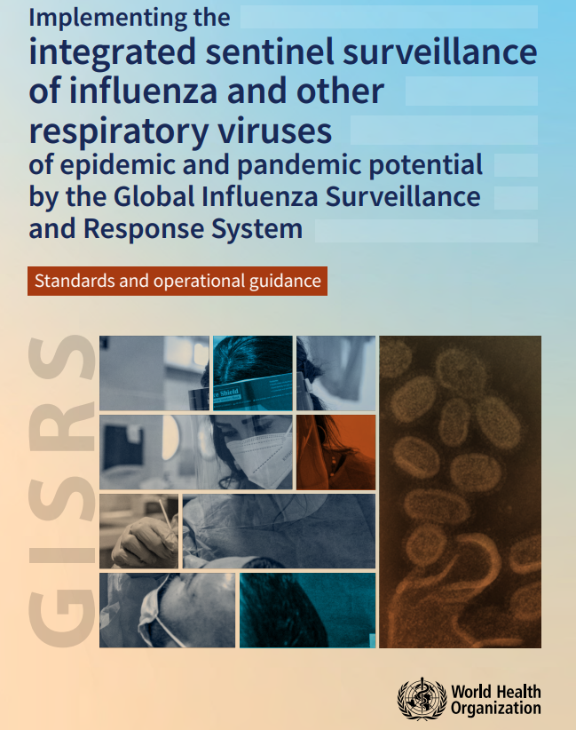
Integrated sentinel surveillance
Expanding GISRS functions to include non-influenza respiratory viruses with epidemic or pandemic potential in order to inform public health interventions
Recommends that all countries implement year-round sentinel surveillance for influenza and SARS-CoV-2. Countries may also consider integrating RSV into sentinel surveillance
Recommended that at least 50 specimens per week are tested (ILI and/or SRI)
Genomic sequencing of as many samples as required, or at least 15 influenza and SARS-CoV-2 positive specimens per week
Implementing the integrated sentinel surveillance of influenza and other respiratory viruses of epidemic and pandemic potential by the Global Influenza Surveillance and Response System

Slide 5
Influenza surveillance programmes in SA
Programme | Viral Watch | Influenza-like Illness (ILI) | Pneumonia Surveillance
Start year | 1984 | 2012 | 2009
Provinces* | EC, FS, GP, LP, MP, NC, NW, WC | KZN, NW, WC, MP | EC, GP, KZN, MP, NW, WC
Number of sites | 98 | 5 | 13
Type of site | General practitioners | Public primary health care clinics | Public hospitals
Case definition | An acute respiratory illness with fever (≥38°C), cough and symptom onset ≤10 days or Suspected SARS-CoV-2: Any person presenting with an acute (≤14 days) respiratory tract infection or other clinical illness compatible with COVID-19** | An acute respiratory illness with fever (≥38°C), cough and symptom onset ≤10 days or Suspected SARS-CoV-2: Any person presenting with an acute (≤14 days) respiratory tract infection or other clinical illness compatible with COVID-19** | Lower respiratory tract illness of any duration, requiring hospitalisation or Suspected SARS-CoV-2: Any person admitted with a physician-diagnosis of suspected COVID-19 and not meeting SRI case definition
Specimens collected | Throat swabs and/or nasal/nasopharyngeal swabs | Mid-turbinate nasal swabs | Mid-turbinate nasal swabs

Slide 6

Molecular testing in CRDM
Respiratory illness surveillance (SARI/ILI/VW)
(Nasopharyngeal or nasal specimens)
Bordetella spp.
(B. pertussis, B. parapertussis,
B. holmesii)
(In-house PCR - Tatti et al, J. Clin. Microbiol 2011)
SARS-CoV-2/FluA/FluB/RSV
(Seegene Allplex™ kit)
Influenza A/B
RSV
SARS-CoV-2
Negative
Ct<40
Ct<40
Ct<35
10% random selection
A(H1N1)pdm09
A(H3N2)
B/Victoria
B/Yamagata
Subtyping
(CDC IRR)
Subgrouping
(CDC IRR)
WGS
Multi-pathogen testing
Respiratory 2.1 (RP2.1) plus
VirCapSeq-VERT sequencing
Metagenomic sequencing
Ct<30
Ct<30
Neg
Influenza A
H5/H7/H9
WGS*
WGS*
*Virus isolation (influenza/RSV) and HAI (influenza) performed on viruses representative of different clades/lineages

Slide 7
Number of influenza cases by subtype/lineage and moving average detection rate by epidemiologic week - pneumonia surveillance in public hospitals, 2018-2023

Slide 8
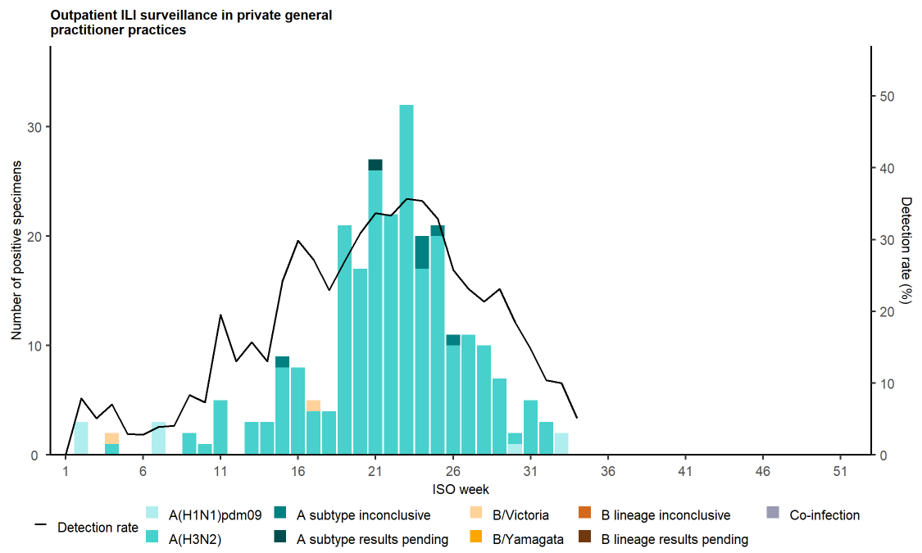
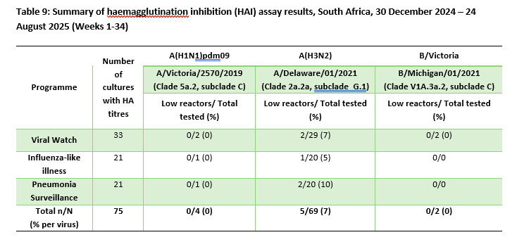
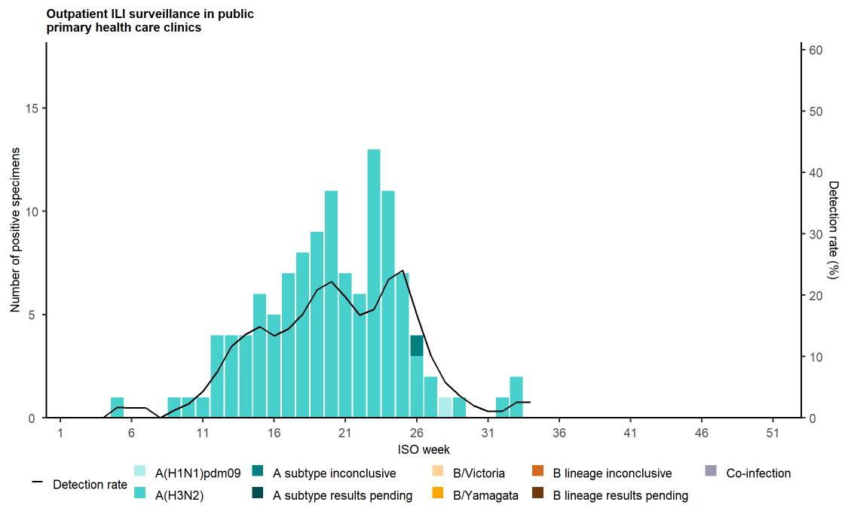
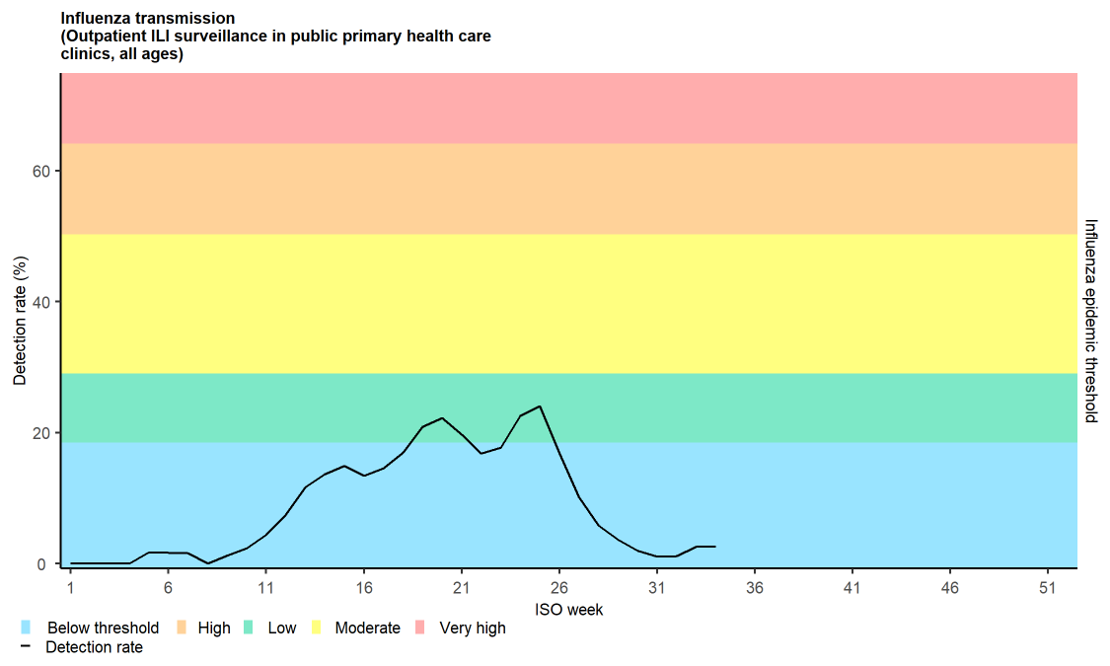
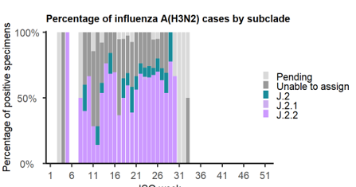
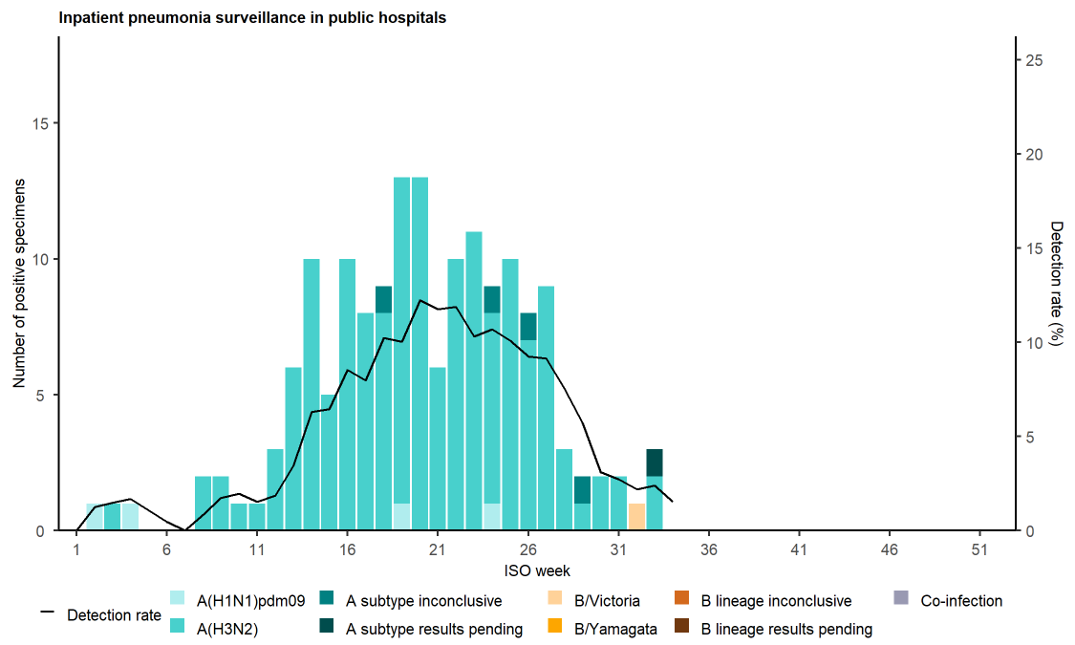
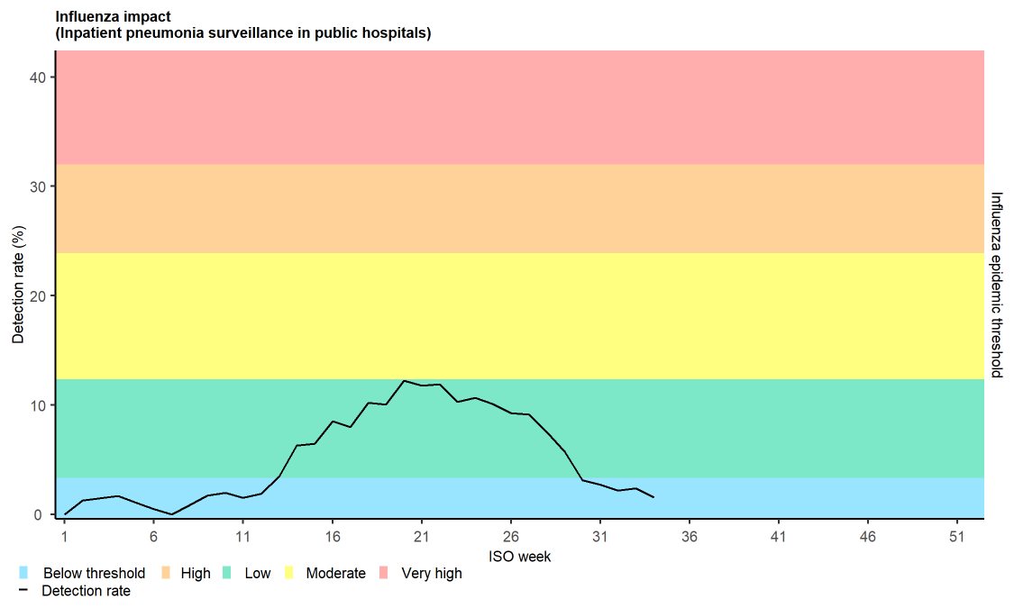
Influenza - 2025
VW
ILI
SRI

Slide 9
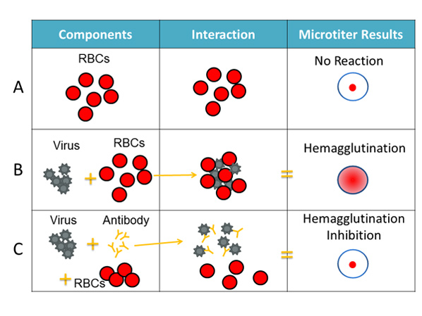
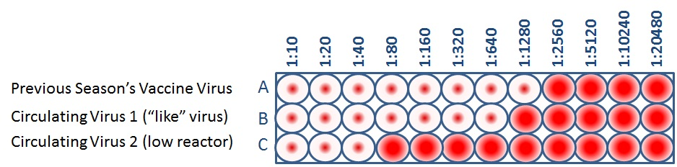
Antigenic characterisation
Hemagglutination inhibition assay (HAI test)
Determine whether antibodies developed after vaccination are similar to circulating influenza viruses
Influenza viruses to be antigenically similar or “like” each other if their HI titers differ by two dilutions or less
Circulating viruses that are antigenically dissimilar (i.e. not “like”) to vaccine virus are considered “low reactors”
https://www.cdc.gov/flu/

Slide 10
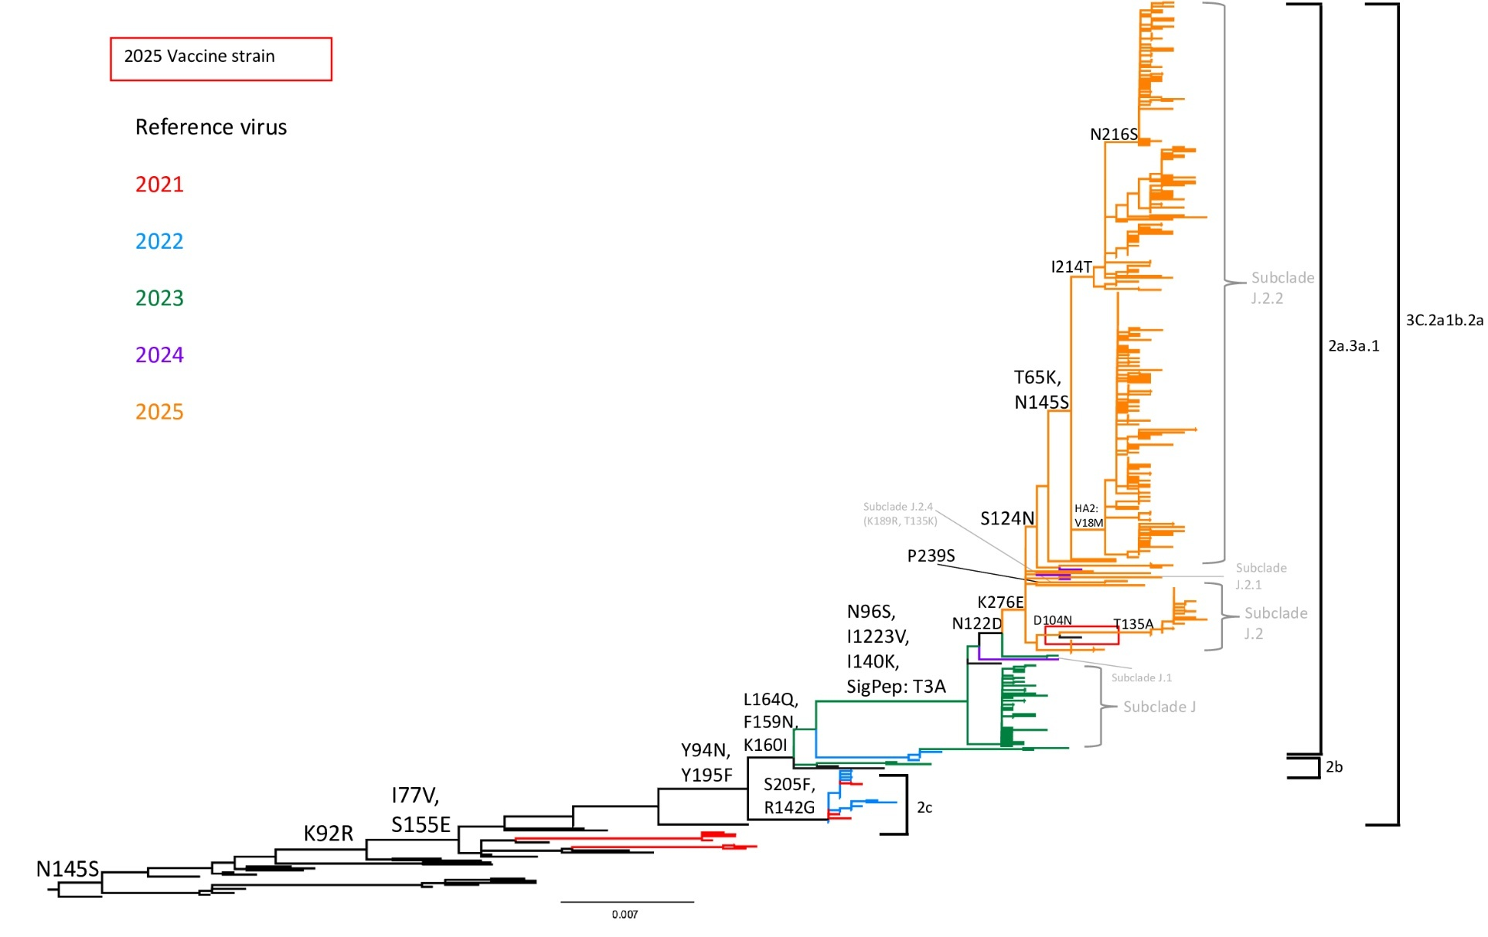

Genetic characterisation
Monitor changes in the genome of circulating viruses
Effectiveness of vaccines and antivirals
https://irepertoire.com/ngs-overview-from-sample-to-sequencer-to-results/

Slide 11
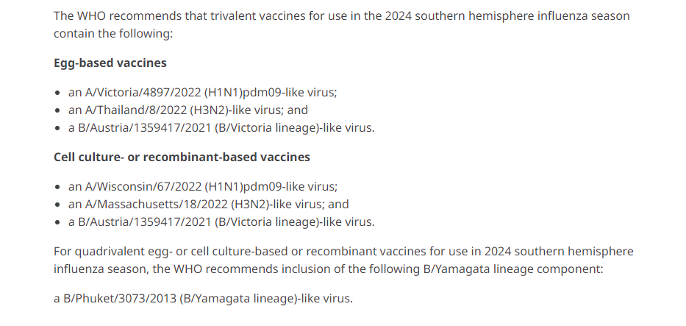
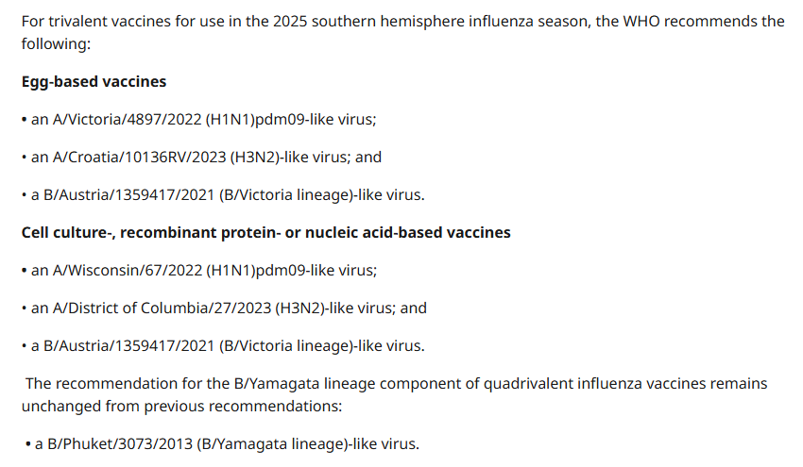
2024 Vaccine Formulation
2025 Vaccine Formulation

Slide 12
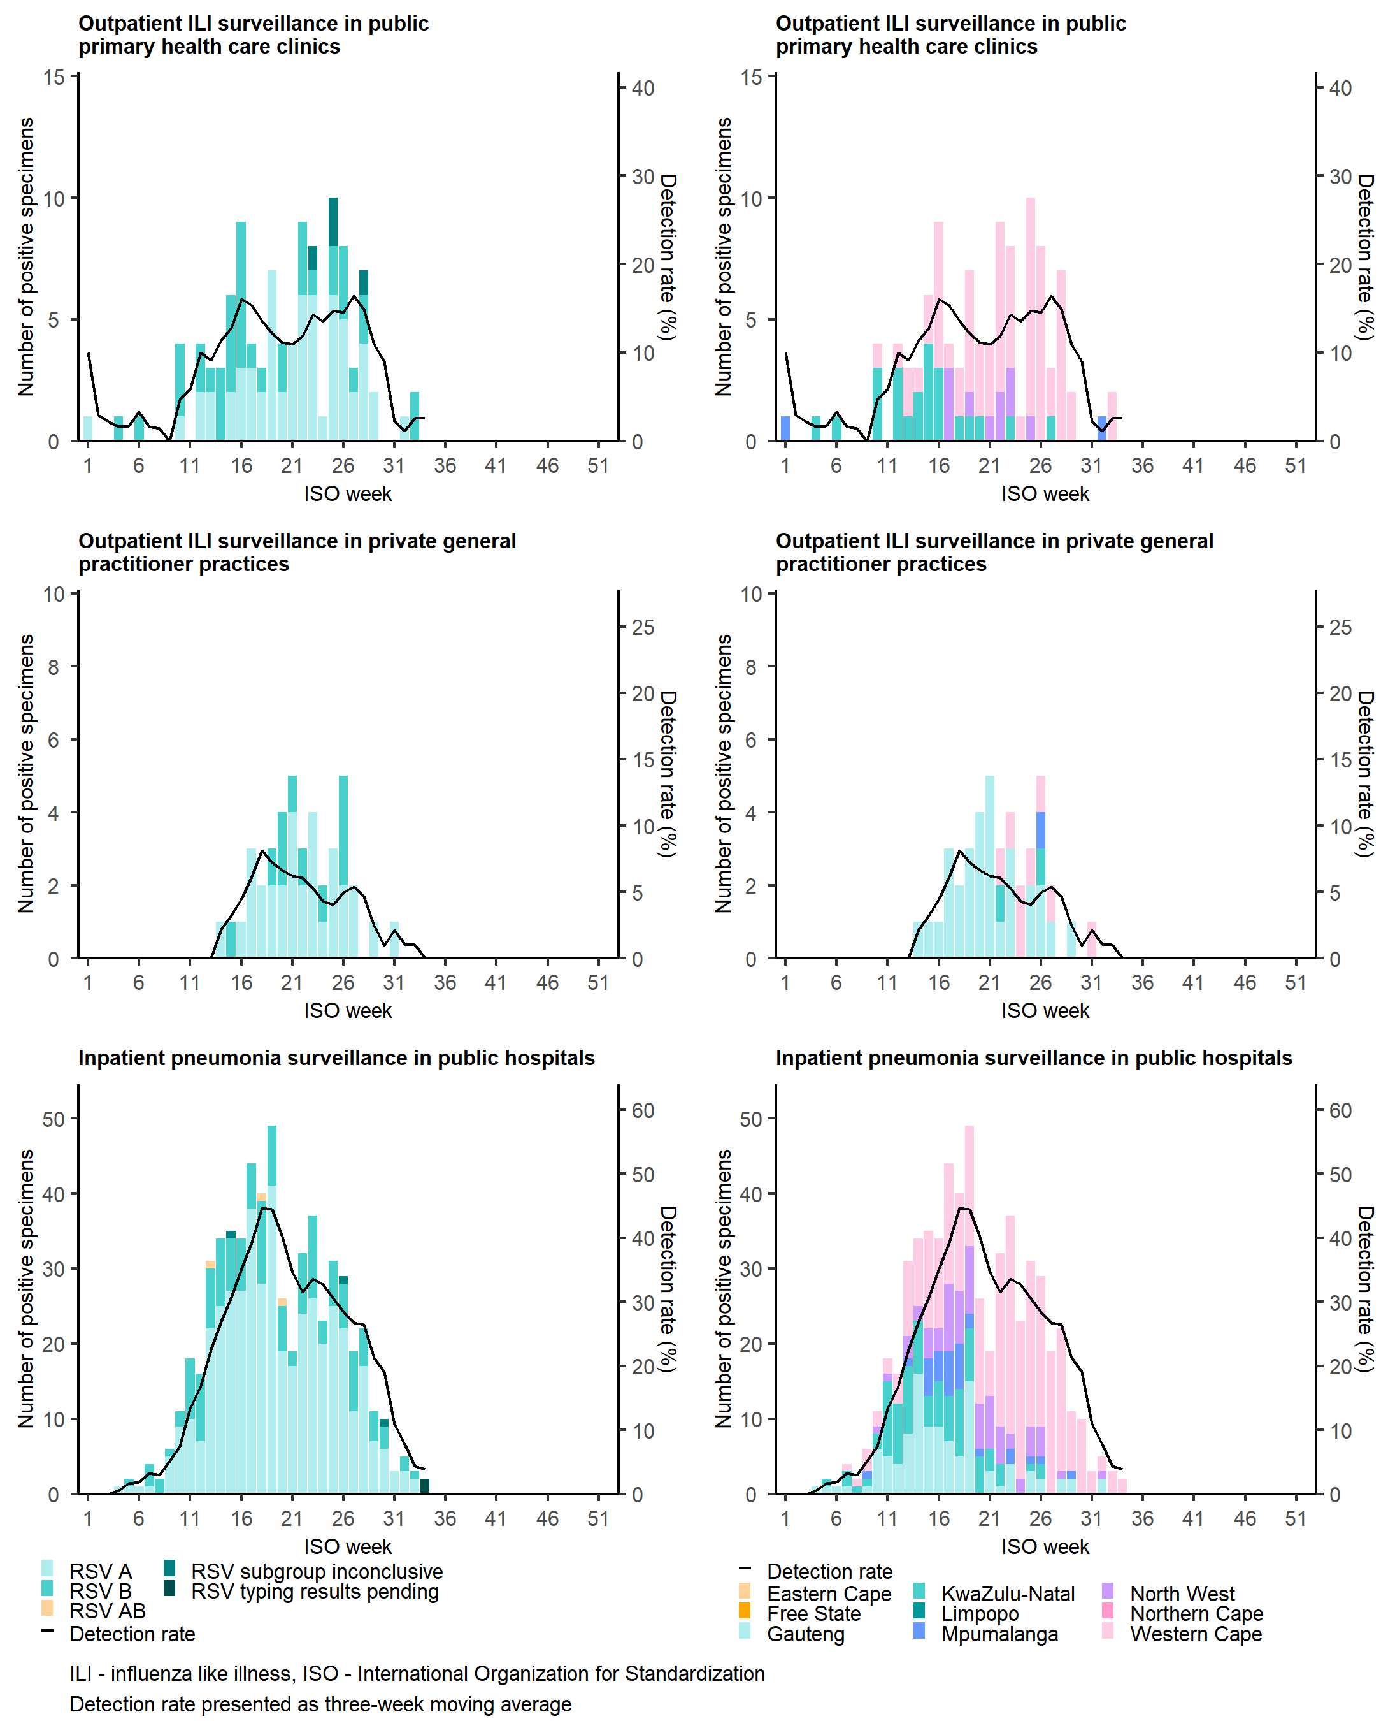
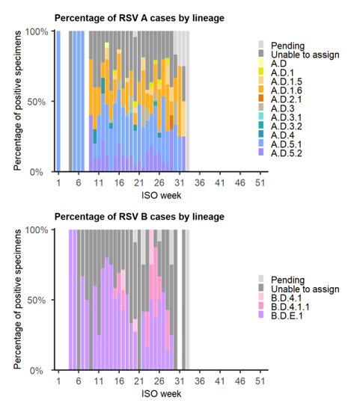
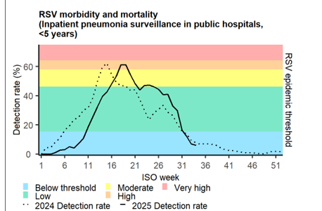
RSV - 2025
VW
ILI
SRI

Slide 13
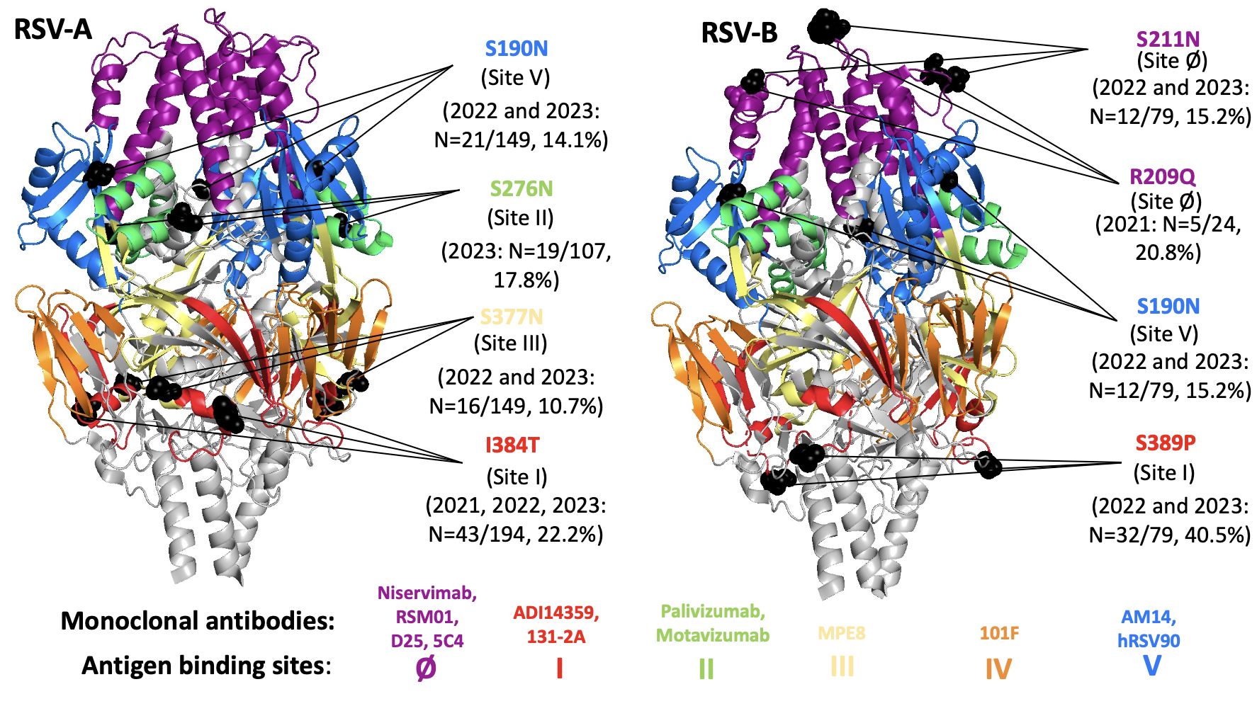
RSV F amino acid substitutions in South Africa (2021, 2023) – relative to GISAID references
F gene: target of many vaccines and monoclonal antibodies, conserved
Six antigenic sites (Ø, I – V) identified – monitor mutations in these sites
Shown here: mutations with ≥ 10% prevalence in RSV-A in our data
Future functional studies to confirm the impact
Notes:
F chosen because vaccine and mAb target – most conserved
Vaccine in stage III trials
Important to monitor to see if circulating strains are likely to be affected/escape
Learned from covid – track mutations and mutation prevalence, especially in NB functional regions
276 and 377 shown to change between seasons

Slide 14

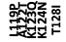
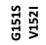


F amino acid substitutions detected in RSV-A sequences over time (2021-2024)
Frequency of amino acid substitutions in the F protein of South African RSV-A and strains shown by year. Each row represents a year (2021-2024). Amino acid changes are coloured by the antigenic site or structural feature in which they occur. Bars represent prevalence of the substitutions relative to the RefSeq reference NC_038235_1

Slide 15
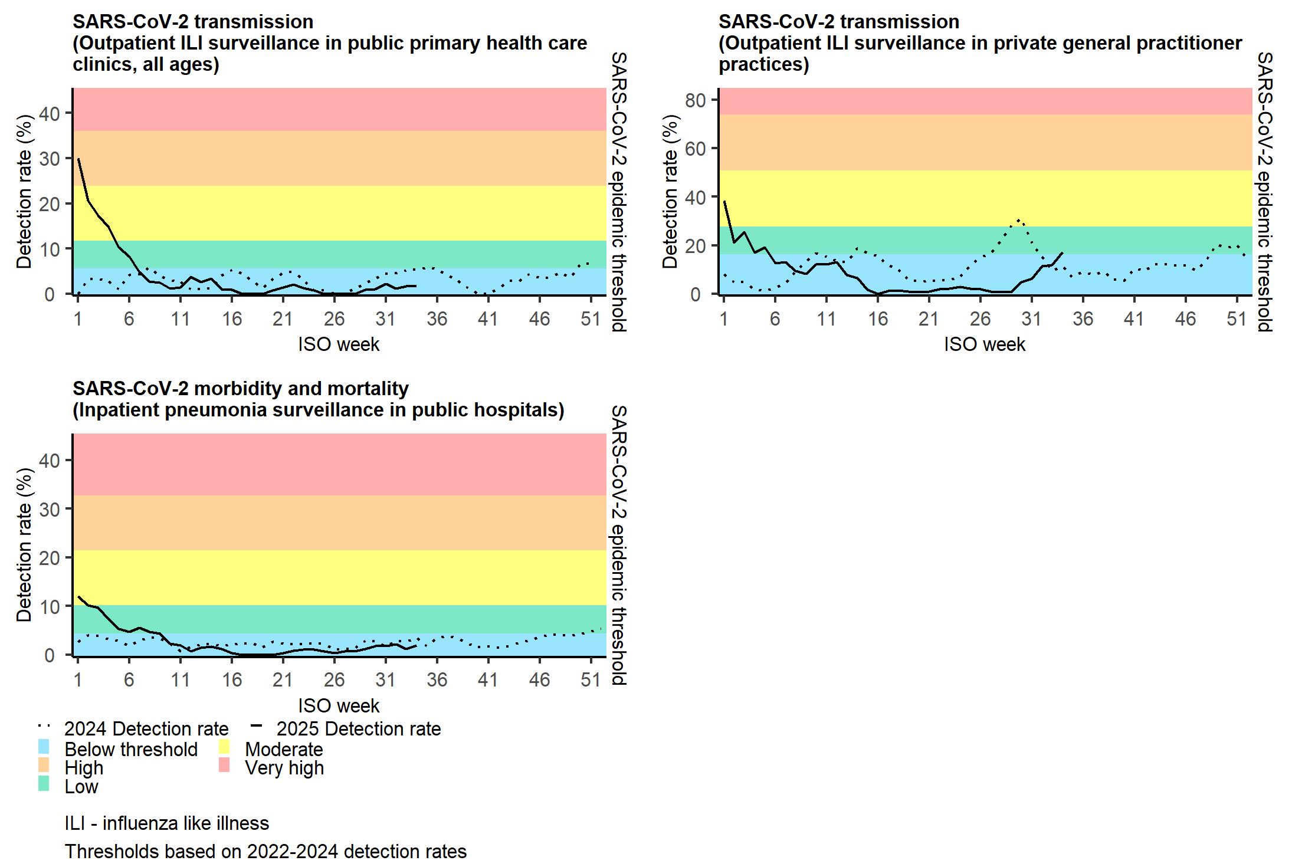
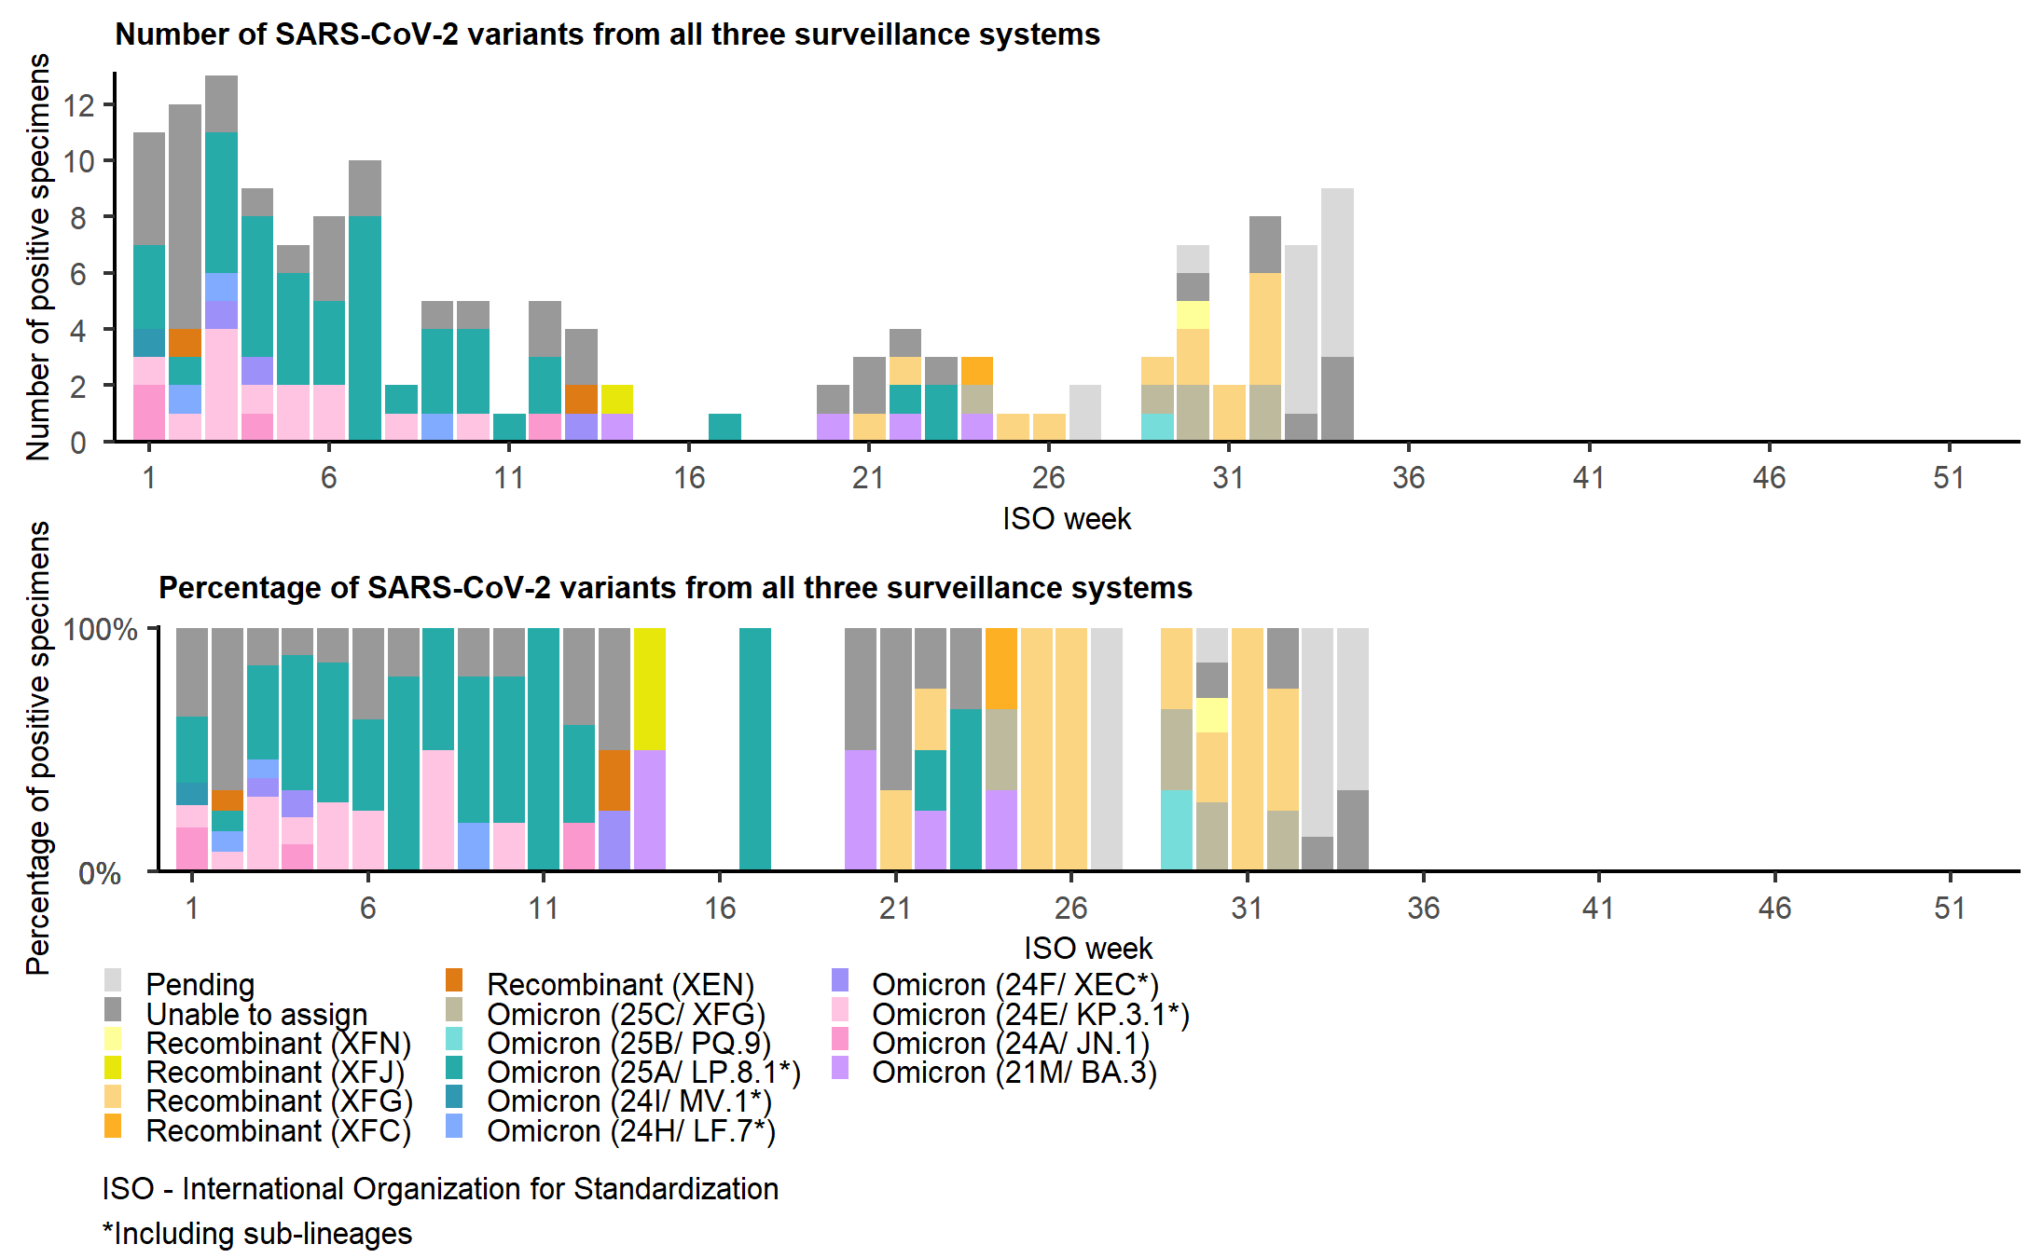
SARS-CoV-2 - 2025
VW
ILI
SRI

Slide 16
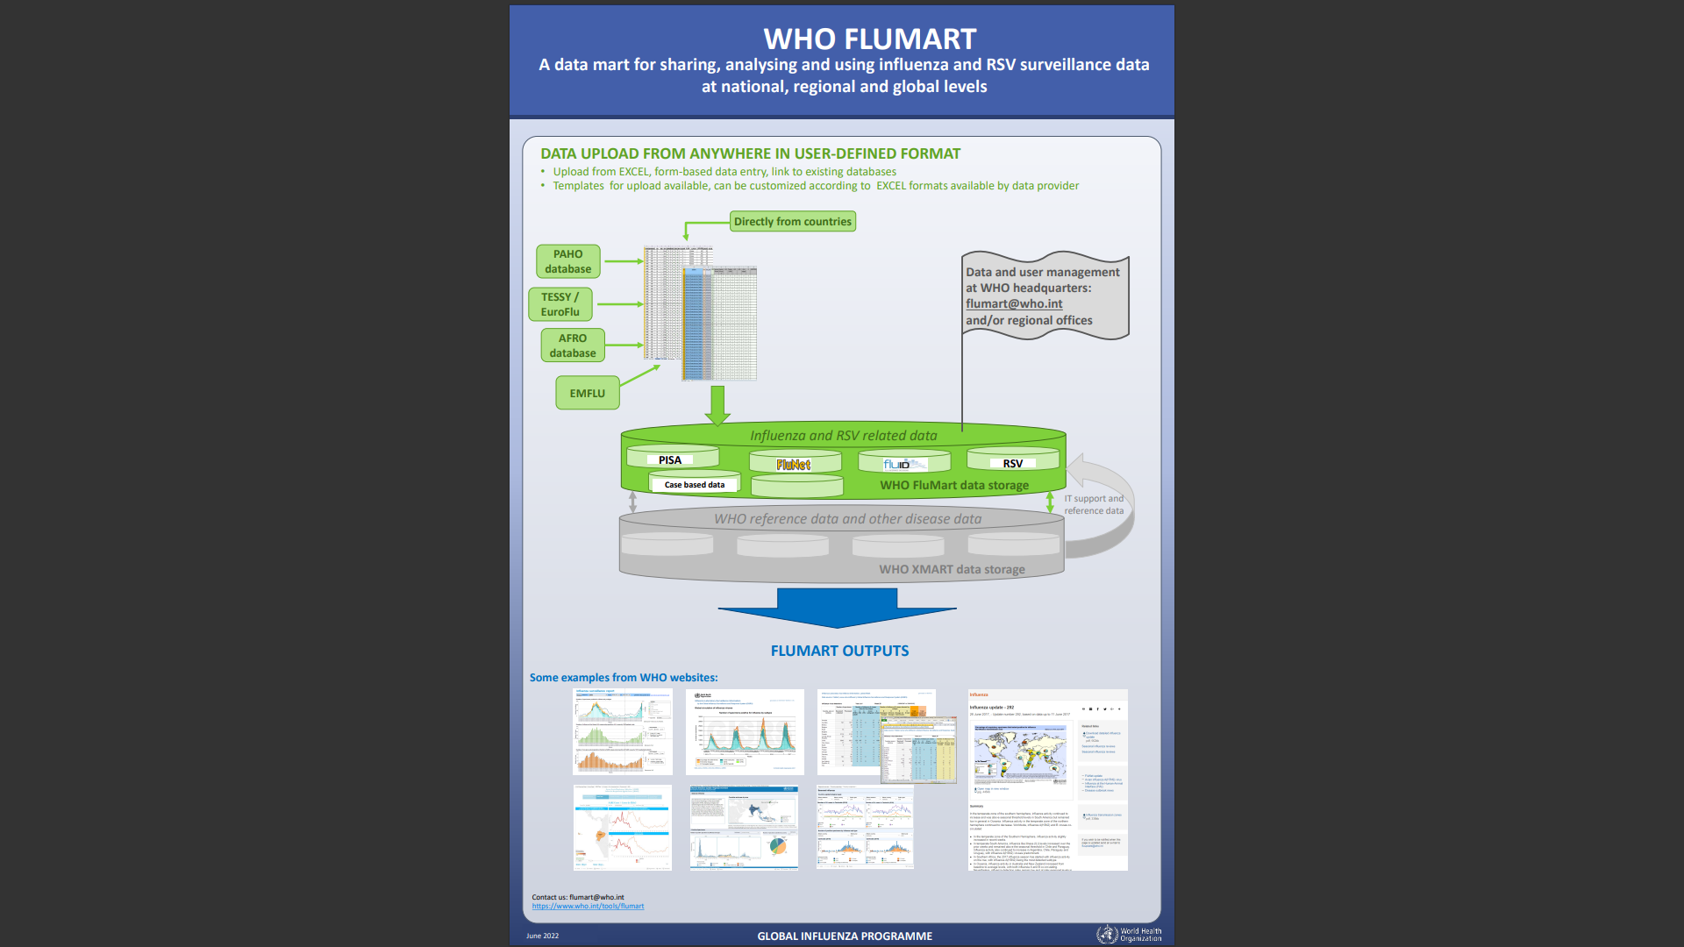
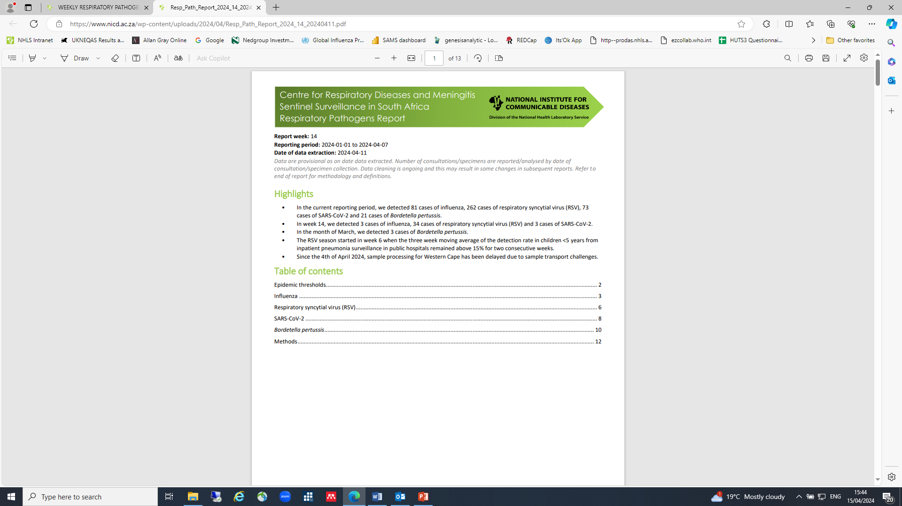
Weekly data reporting nationally and to World Health Organization
GISAID - gisaid.org
https://www.nicd.ac.za/diseases-a-z-index/disease-index-covid-19/surveillance-reports/weekly-respiratory-pathogens-surveillance-report-week/
https://www.who.int/tools/flunet/flunet-summary

Slide 17
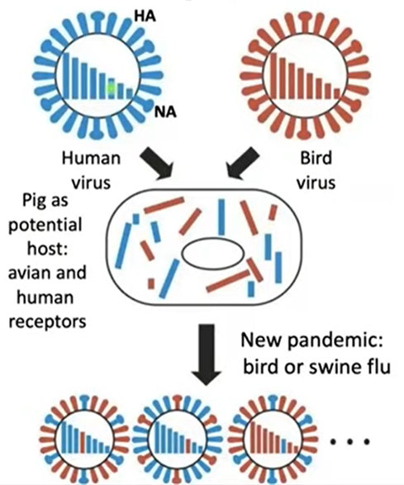
Co-infection with influenza viruses can lead to new pandemic viruses
Pandemic causing influenza viruses
Arise from reassortment/recombination between zoonotic and human viruses
Reassortment = process by which viruses swop gene segments
Two influenza viruses infect a host at the same time and swap genetic information
Antigenically distinct from previous human influenza virus subtypes
No prior immunity
Slide courtesy of Jinal Bhiman, NICD

Slide 18
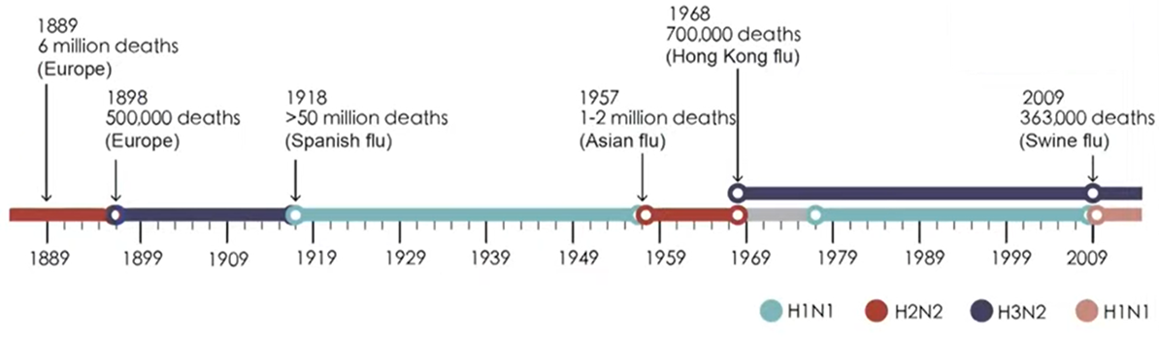
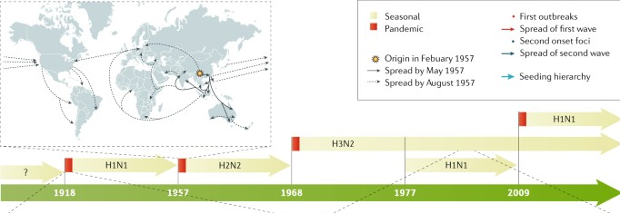
Influenza A pandemics due to Ag shift
CDC and adapted from Taubenberger et al 2019; Kramer, 2018
Notes:
Four pandemics in past 100 years

Slide 19
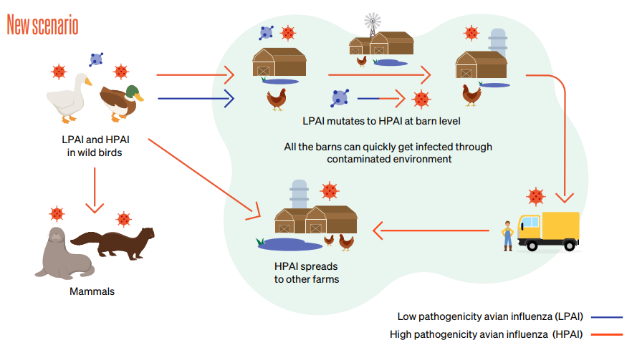
Avian Influenza in Birds
Wild aquatic bird species - natural reservoir
Can infect domestic poultry and other bird and animal species
Virus replicates in GI tract
Viruses shed in saliva, nasal secretions
and faeces
Transmission primarily by faecal-oral route
>420 million domestic poultry
died/culled since 2005 globally
https://www.cdc.gov/flu/avianflu/index.htm; https://www.woah.org/en/disease/avian-influenza/; Shi et al., Emerg Microbes Infect. 2023

Slide 20
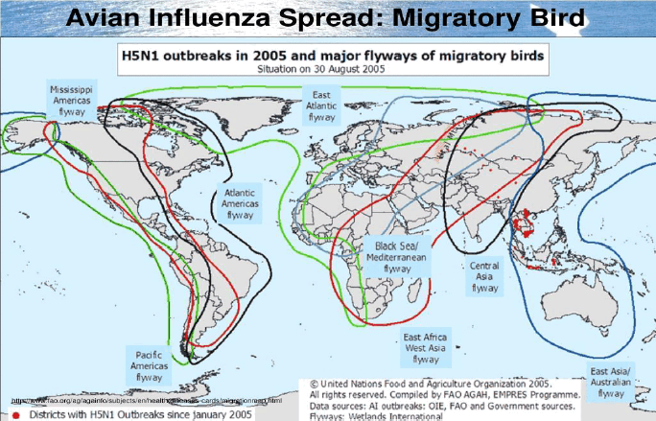
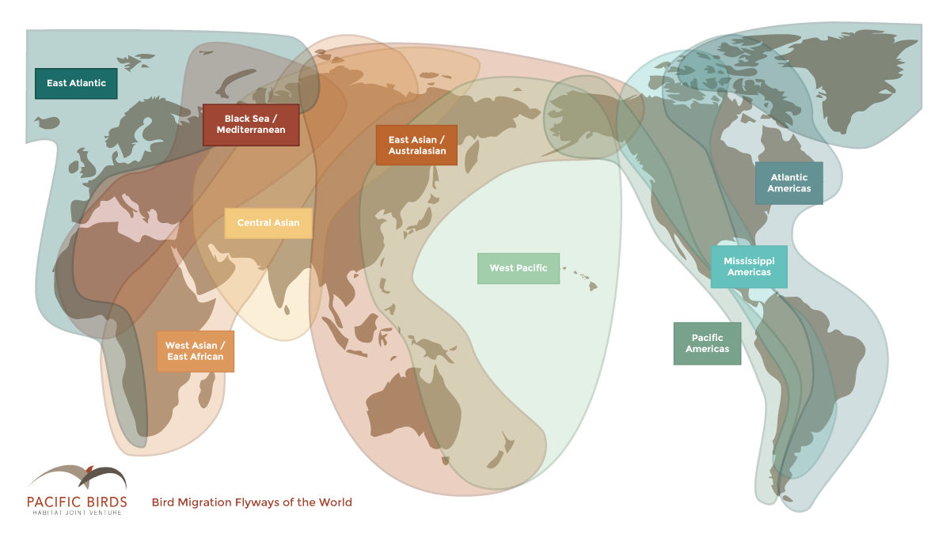
Migratory bird flyways

Slide 21
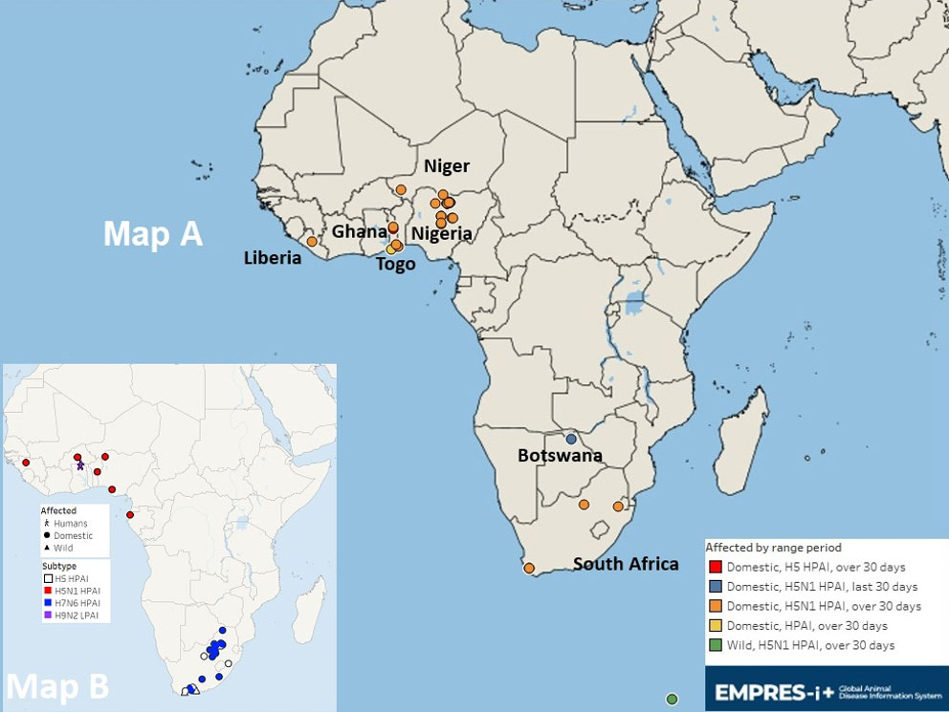
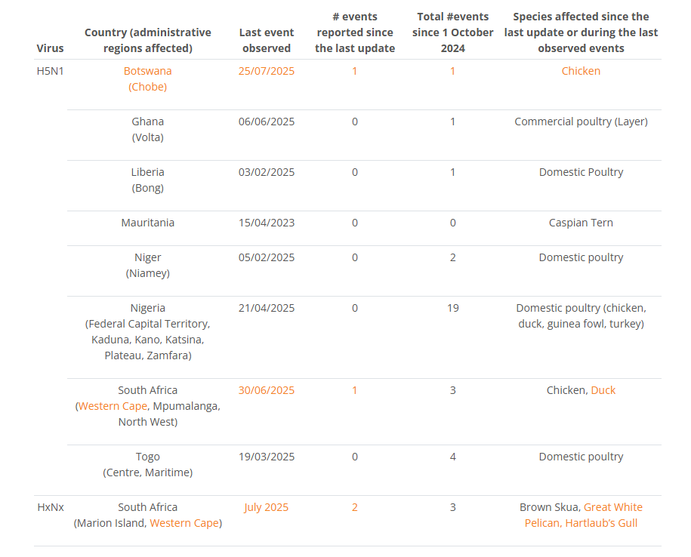
Officially reported HPAI outbreaks (H5Nx and H7Nx subtypes) in sub-Saharan Africa, by onset date (1 October 2024 to date)
HPAI events: 1 October 2023 to 30 September 2024
https://www.fao.org/animal-health/situation-updates/sub-saharan-africa-hpai/en

Slide 22
How do we prepare for the next pandemic?
Close collaboration with the animal health and environment sectors
Surveillance for human infections with avian influenza A viruses
Vigilance for the emergence of novel influenza viruses of pandemic potential
Characterise influenza viruses from animals or from people timeously
Share data and influenza viruses on a timely basis

Slide 23
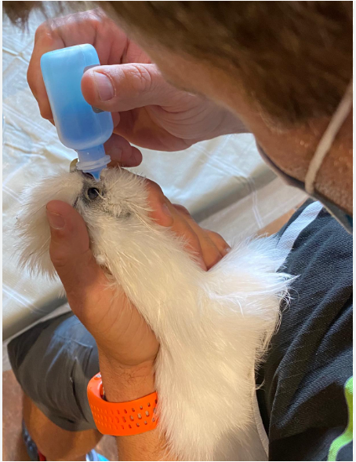
Vet Watch: Sentinel surveillance for avian influenza in humans exposed to wild birds or poultry, South Africa
Sites close to poultry farms and wild bird treatment centres
Veterinary practices, provincial animal health services, clinics/GPs providing services to poultry farm workers
Continual surveillance even in absence of outbreaks
Case definition: conjunctivitis, cough, fever, myalgia, chest pain, difficulty breathing
Online case investigation form, self-collected nasal swab sent to NICD
Specimens tested by multiplex rRT-PCR and WGS
Identify and characterise influenza viruses
Identify novel or emerging pathogens
Serosurveys conducted during/after outbreaks

Slide 24
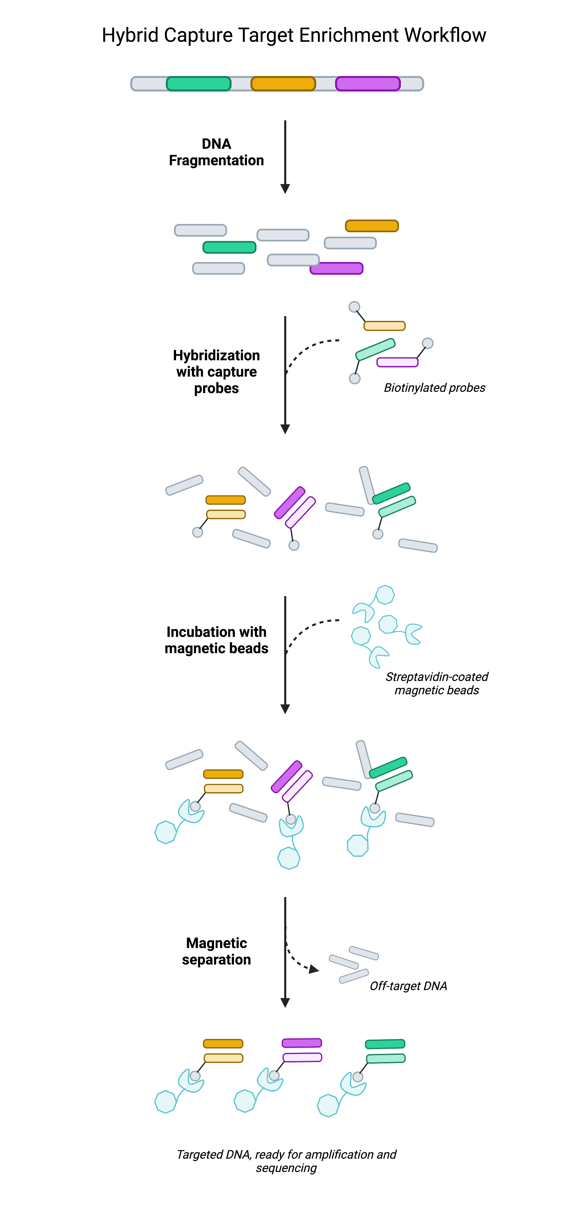
Emerging virus detection methods
Target capture sequencing methods
Capturing certain genomic regions of interest by hybridization to target-specific probes, which are then isolated and sequenced with next-generation sequencing
VirCapSeq
Illumina kits – RPIP, VSP
Metagenomic sequencing
Untargeted (unbiased) sequencing of all nucleic acids in a sample
Detects unknown or novel viruses without prior knowledge of the sequence

Slide 25
Respiratory Virus Network in Africa
Aim:
To establish a regional network of laboratories in sub-Saharan Africa that can serve as a resource for
Genomic surveillance,
Diagnostic expertise and
Research
in the field of respiratory viruses on the continent, and thereby improve our ability to rapidly detect and respond to outbreaks.

Slide 26

What do we hope to achieve this week?
Build relationships and networks
Share experiences, challenges and lessons learnt
Overview of sentinel surveillance systems for respiratory illness
Lab capacity, testing and sequencing algorithms
Animal and zoonotic surveillance in your country and region
One Health collaborations in your country and region
Understanding barriers to timely information sharing (political, technical, financial)
Suggestions on how we can improve collaborations and pandemic preparedness within our network

Slide 27


Proposed names
Respiratory Virus Network Africa (ReViNA)
Respiratory Pathogen Network Africa (RespNet-Africa)

